Slide 1
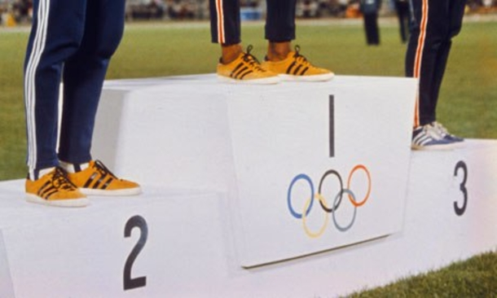

GOING FOR GOLD: predicting Nations Olympic medal performance
Group 9
Linyuan Xing
Jingxin Nie
Mark Mendoza
Timothy Le Pers
Notes:
Hi I’m Tim Le Pers and I’ll be giving the initial introductory part of Group 9’s presentation on the work we did trying to model and predict nations Olympic medal performances.

Slide 2
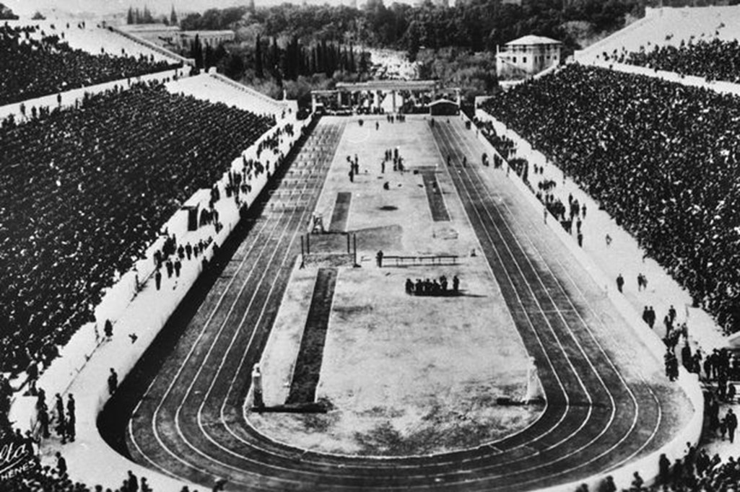


Motivations
Competing at the Olympics are source of national pride and identity for athletes, and the citizens they represent
Multiple factors may increase the probability of success at the Olympics apart from skills and training, such as:
Country GDP per capita
Country population
Number of participating athletes from a country
Understanding what factors most influence Olympic performance can inform future investments by governments and other stakeholders
Notes:
There’s a lot of different motivations to do research into what makes a country do well at the Olympics. A countries performance in the Olympics is a big source of national pride and identity not just for the athletes but the citizens that support them as well. What this means is that governments have to care about this when thinking about how much money to spend on sports programs. We wanted to see if there were factors related to the country as a whole that affected the countries performance, rather than focussing on what makes individual athletes do well. We hypothesised that the most influential factors in a nations performance as a whole would be the countries GDP, Population and the number of athletes sent to the Olympics. We took this approach because we wanted to think of large scale recommendations that could be made to governments that were interested in improving their countries overall performance at the Olympics.

Slide 3

Design thinking
Governments
Citizens of participating countries
Participating athletes
Sporting regulatory bodies
National Olympic Committees
What factors determine how well a country “should” perform at the Olympics?
Notes:
Governments aren’t the only stakeholders though. Bodies like the national Olympic committees and sporting regulatory bodies would be interested in this kind of research, as well as the athletes themselves and citizens of the participating countries. A question that we believed encompassed all of these stakeholders’ interests was “What factors determine how well a country should perform at the Olympics?” and so we aim to perform our analysis with this question in mind.

Slide 4
Getting the Data I Need
Dataset: | Years Covered: | Source:
Summer and Winter Olympics Participants and Medal Outcome | 1896 – 2012 | IOC (posted to Kaggle)
World Statistics Data by Country | 1960 – 2018 | World Bank (posted to Kaggle)
Year | Olympic City | Sport | Discipline | Athlete Name | NOC Code | Gender | Event | Medal | …
numeric (integer) | character (string) | character (category) | character (category) | character (string) | character (category) | character (category) | character (string) | character (category) | …
Country | Country Code | Year Data Obtained | GDP per capita (US$) | Birth Rate (per 1000) | Mortality Rate (per 1000) | Population | Land Area (km²) | Average Rainfall (mm) | ...
character (string) | character (category) | numeric (integer) | numeric | numeric | numeric | numeric | numeric | numeric | …
Notes:
Initially we obtained two data sets for this investigation both of which were readily obtained from Kaggle in csv formats. The first was a dataset listing details about Olympic medal winners from as far back as 1896 to 2012. This dataset included information like what sport the medal was awarded in, what country the athlete was from, whether they were male or female and lots of stuff like that. The second was a dataset that was put forward by the world bank which contained yearly data for a large number of countries. The dataset contained a large number of columns that were irrelevant for our study but as it contained countries GDP and populations and we thought that maybe if we had time we would be able to look at some other factors effect on countries performances we decided this dataset was suitable for our purposes. There were some issues with the data however which I’ll now let Mark discuss.

Slide 5
Making the data fit for use
Datasets:
Summer and Winter Olympics Participants and Medal Outcome
World Statistics Data by Country
National Olympic Committee (NOC) codes with country name
Observations:
Some countries in the new set will have multiple codes assigned to them (e.g. Russia = URS, RU1, RUS)
Four teams do not have data in [2] for any year – Cook Islands, Palestine, Taiwan, Refugee Olympic Athletes
Data Quality Measure | Reason | Fix
Incorrect | [3] – Typos (e.g. Bolivia misspelt as ‘Boliva’) | Added correct NOC and/or country name manually
Incomplete / Missing | [3] – Missing SGP and HKG [2] – NA for missing statistics [1] – Athletes who did not win medals recorded NA by default | Added missing NOC/country names manually NA statistics will be excluded later on Added “DNW” to blank medal records
Inconsistent | [3] – One country had multiple NOC codes [1][3] – Some countries had name changes (e.g. USSR to Russia) | Field matching on correct NOC and/or modern country name Previous country name updated to modern name
Notes:
Hi everyone, my name is Mark and I’ll be talking about how we cleaned and processed the data we acquired.
We decided to link 1 and 2 via a common primary key – aided by a supplementary dataset containing National Olympic Committee code (NOC) and country names from Kaggle.
We then checked for other data quality measures.
Dataset [3] had incorrect data such as typos in country name and even missing NOCs such as Singapore which was manually fixed.
Dataset [2] was incomplete - for example, not all countries had GDP and population data for every year but this would be dealt with on a case to case basis by excluding NA values.
For dataset [1], NA values were on each record of an athlete that did not win a medal. This was fixed by adding a “DNW/did not win” character string.
When we joined dataset [3] to [2] via Country name as primary key, we found that several records didn’t join due to inconsistency (such as having USSR versus Russia), so these were then manually altered before re-joining.
A limitation of the final dataset was that no GDP/population data was found for 4 teams listed, but we continued with analysis given that participation of these teams comprise only 3.5% of records.

Slide 6
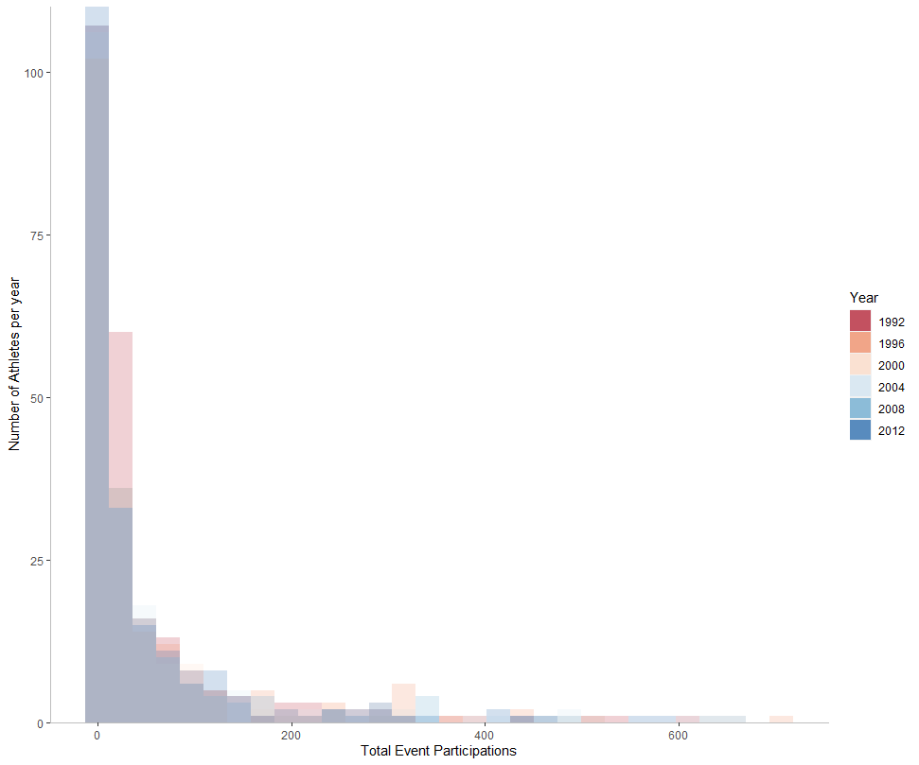
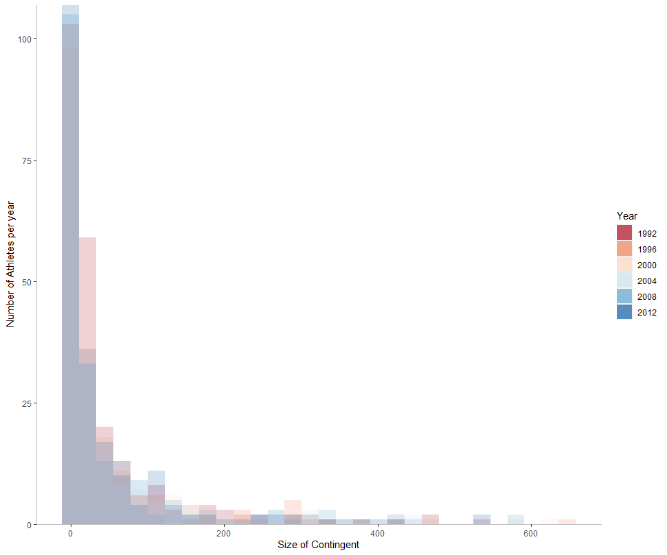
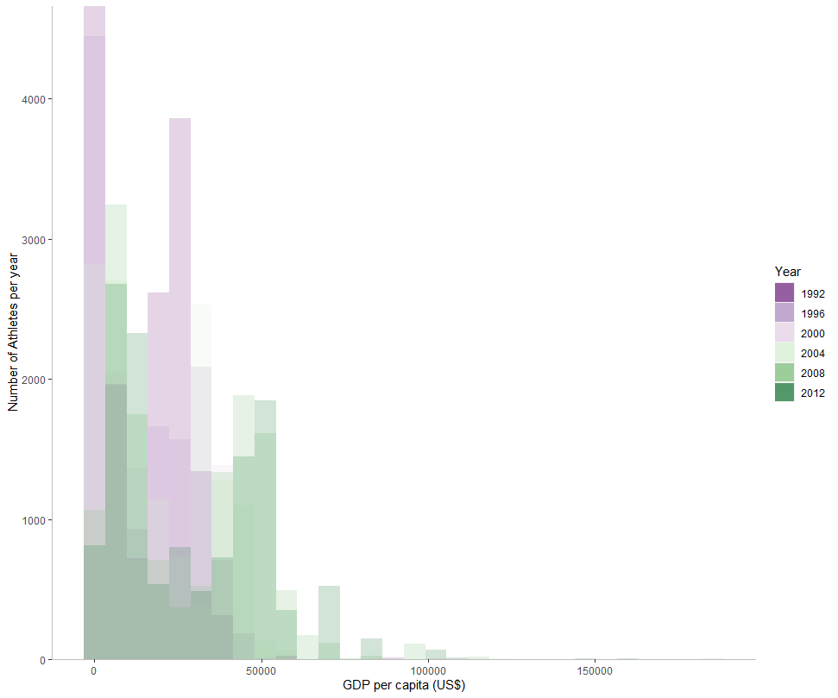
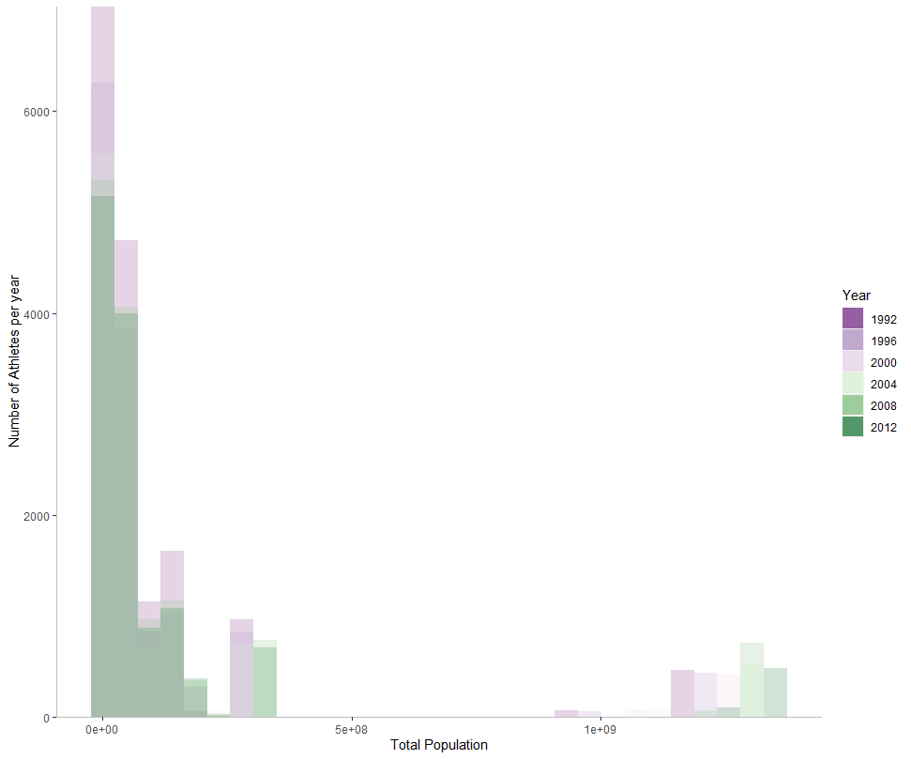
Making the data fit for use
Initial data analysis:
Population is left skewed, but has a second peak (from China, USA, Russia and India)
GDP has two peaks
Total contingent and event participations are heavily left skewed
Notes:
After obtaining the clean data sets, we conducted initial data exploration which involved looking at the distribution of some key attributes.
Most athletes came from countries with < 50 million people, with another peak made by high population countries.
In terms of GDP there are two main peaks, for 0-$10,000 per capita and $40,000-50,000 per capita.
Total contingent is the number of athletes that are sent to a games by a single country. You can see here that the overall distribution has not changed from 1992 to 2012.
Total event participations accounts for when a single athlete attends multiple events. The distribution is also left skewed.
I’ll now pass to Linyuan to discuss further exploratory data analysis.

Slide 7
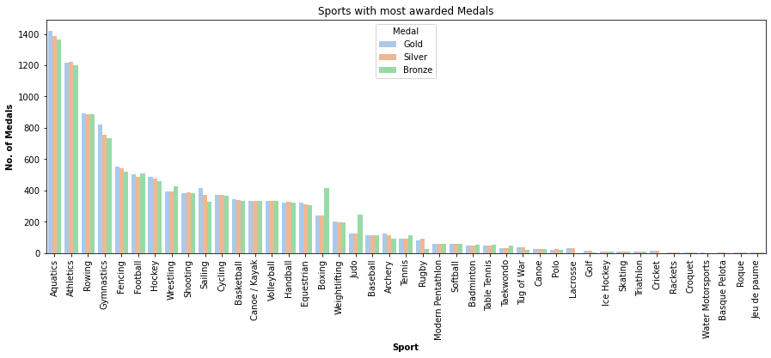

Exploratory data Analysis
The data allows us to explore:
Sports with the most awarded medals
Notes:
Next, I will introduce the Exploratory Data Analysis:
We generated a bar chart which could find the sport with most awarded medals, we can clearly see the most medals is Aquatics. If the government want to get more medals, they could focus on the Aquatics.
We found two interest sports which are boxing and judo.
At first, we think they are wrong data, but after we checked them in the internet, we found the real reason:
There are two bronze medals because of the special competition system for boxing and judo. It‘s interesting.

Slide 8
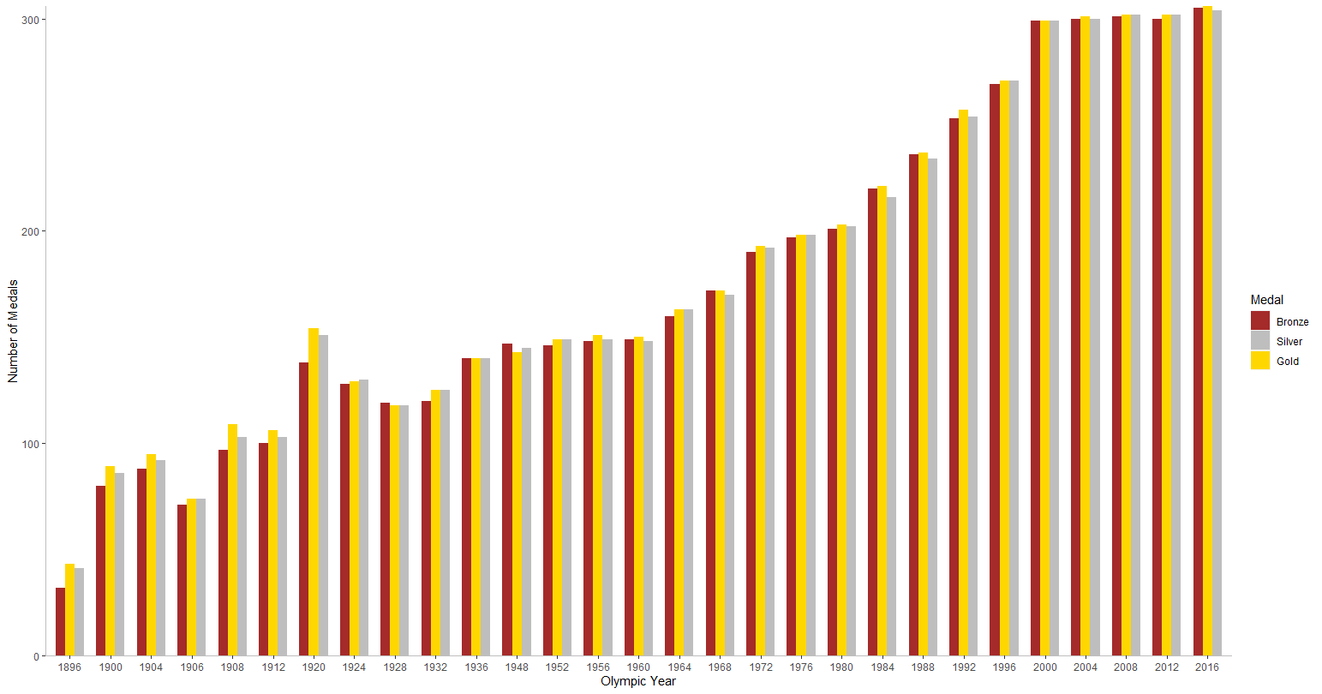
Exploratory data Analysis
The data allows us to explore:
Sports with the most awarded medals
Number of awarded medals each Olympic games (Summer shown)
Notes:
We have generated a bar chart based on the data of medals which showing the number of medals produced for each year.
We could clearly see that the overall trend in the total number of Olympic medals is increasing year by year.
Why are the three medals different in the same year ?
The reason is some sports will produce side-by-side first or side-by-side second and third. When two athletes are tied for first place, two gold medals and one bronze are produced.

Slide 9
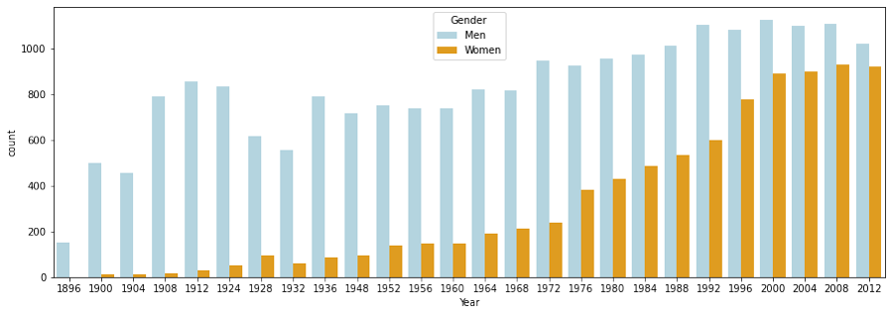
Exploratory data Analysis
The data allows us to explore:
Sports with the most awarded medals
Number of awarded medals each Olympic games (Summer shown)
Gender of participating athletes
Notes:
More and more female athletes in the Olympics.
As this bar chart, the relationship between gender and medal.
We can see that in eighteen ninety-six, almost no female athletes in the Olympic. But with the progress of the times, more and more female athletes participated in the Olympic. For governments, they should pay more attention on female in the future.

Slide 10
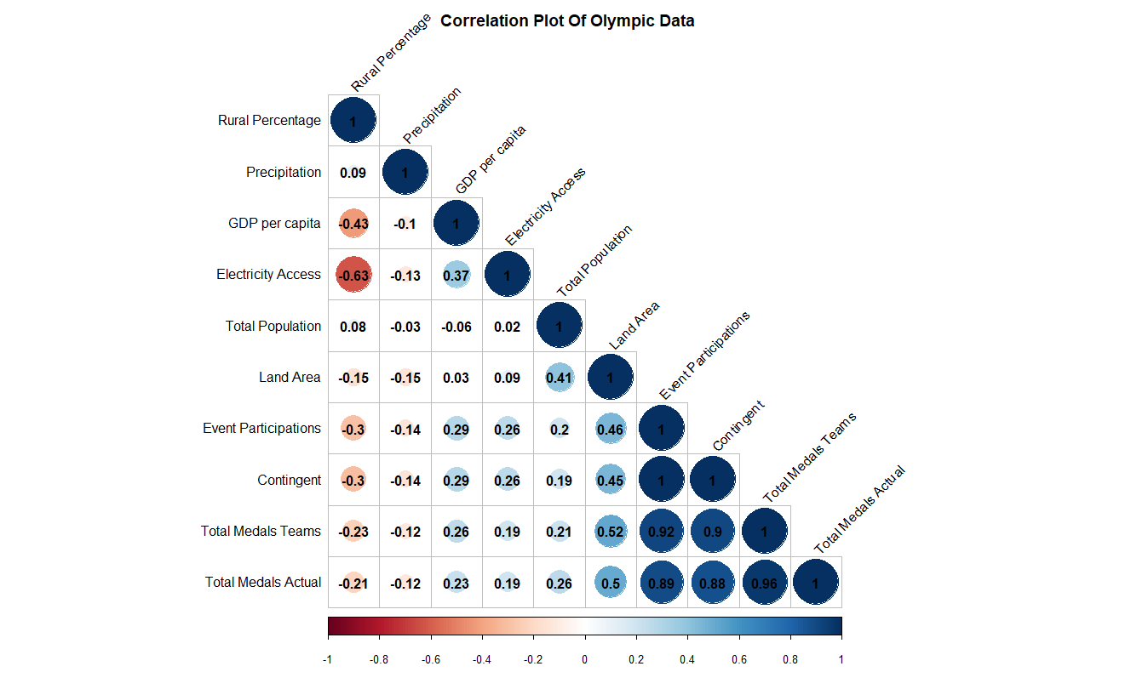
Exploratory data Analysis
The data allows us to explore:
Sports with the most awarded medals
Number of awarded medals each Olympic games (Summer and Winter)
Gender of participating athletes
Correlation between relevant data attributes
Notes:
This is a correlation chart showing the linear correlation coefficients between all attributes of our final data set.
The bottom row shows the number of actual medals awarded versus each of the factors.
We can see that event participations are heavily correlated with total medals.
Highlighted in yellow are the two factors (GDP per capita and Total Population) that we have chosen to build a model initially.
This is because they are extraneous factors to Olympic participation, unlike the number of event participations.

Slide 11
Making the data confess
1. Further Data Processing:
Only GDP per capita and total population factors modelled.
Total medals assume each team member won a medal.
Data for 2012 London Olympics only.
Standardized the data to eliminate the influence of different unit variables.
Raw Data
Scaled Data
GDP (US$ per capita) | Total Population | Total Medals
641.87 | 31,161,376 | 1
13,082.66 | 41,733,271 | 20
3,681.86 | 2,884,229 | 2
68,012.15 | 22,733,465 | 114
… | … | …
GDP (US$ per capita) | Total Population | Total Medals
-0.926 | -0.205 | -0.592
-0.380 | -0.160 | -0.169
-0.793 | -0.325 | -0.570
2.029 | -0.241 | 1.9212
… | … | …

Slide 12
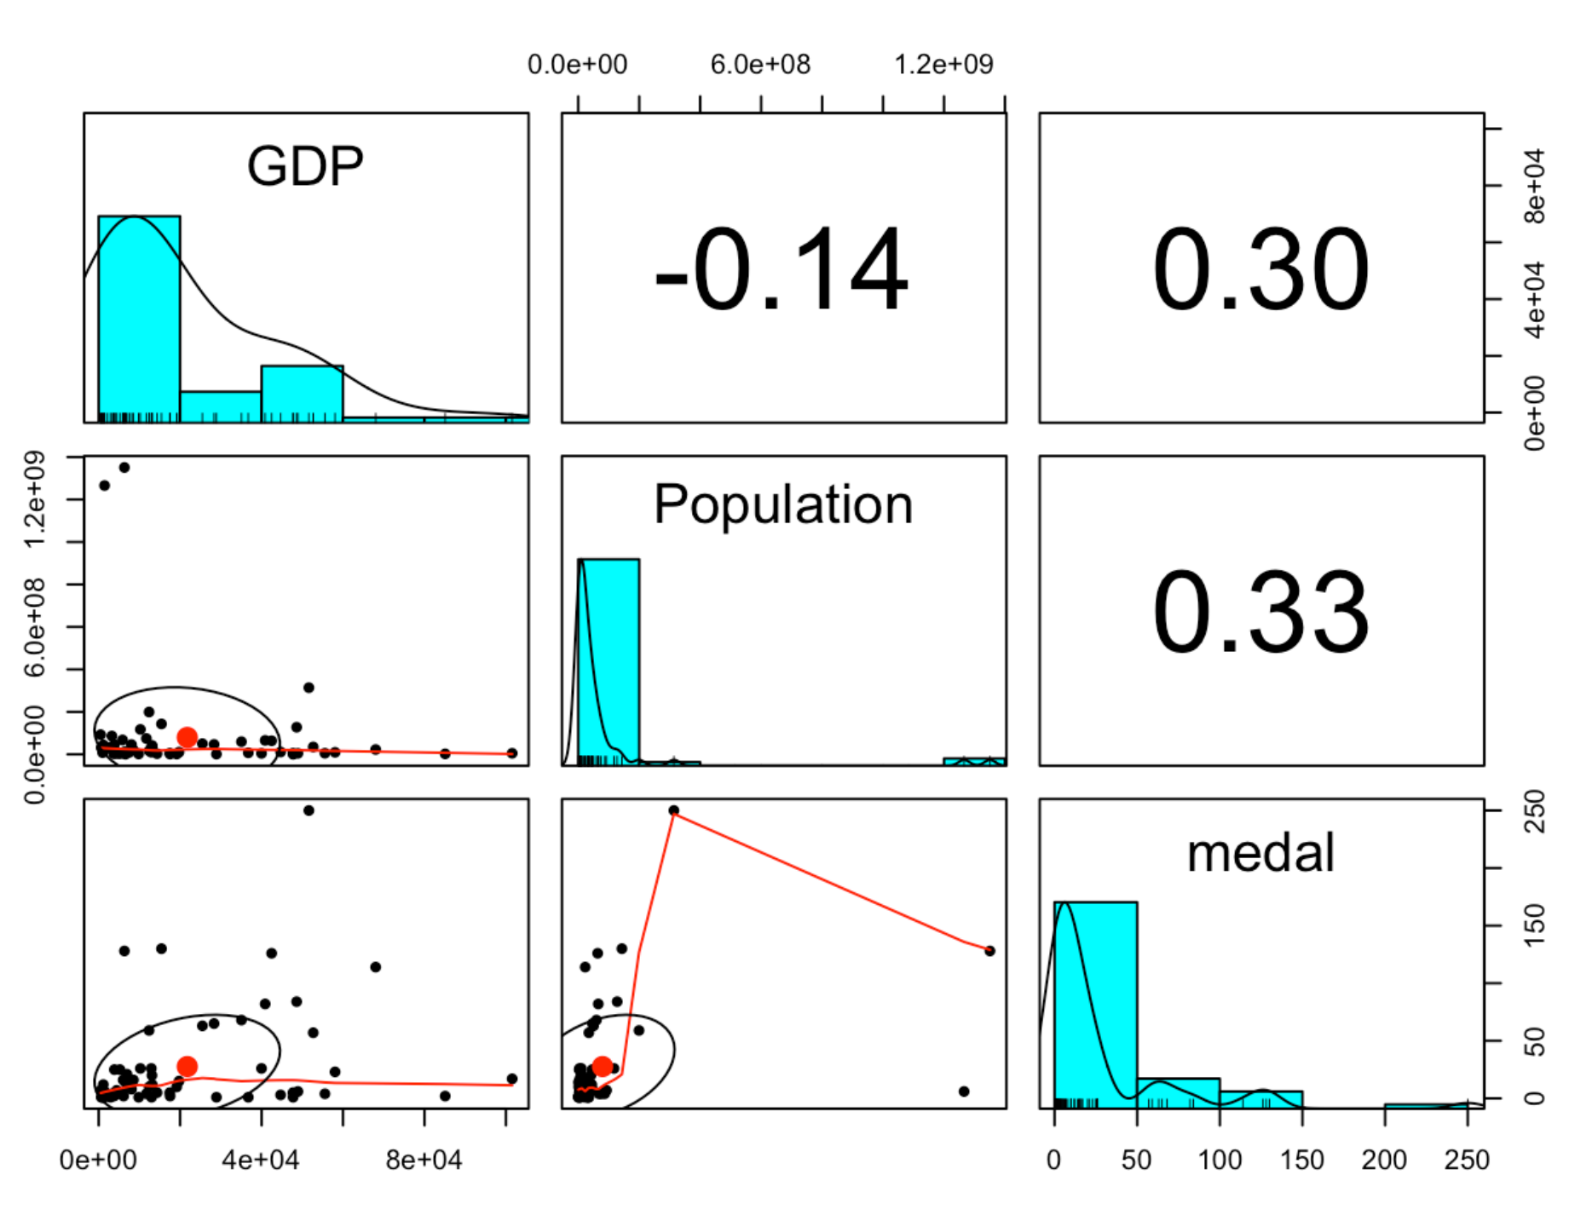
2. Linear Correlation:
When GDP per capita and total population increase, total medals also increases.
Slight linear correlation observed.
Correlation scatter plot and correlation coefficient

Slide 13
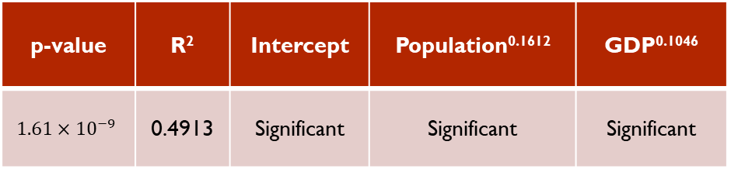
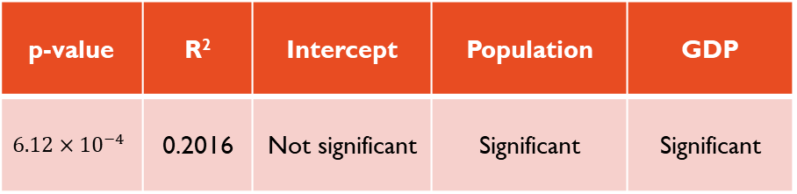
3. Model and Improvements
Linear regression model
Non-linear regression model
p-value | R² | Intercept | Population | GDP
$$6.12×{10}^{−4}$$ | 0.2016 | Not significant | Significant | Significant
p-value | R² | Intercept | Population^{0.1612} | GDP^{0.1046}
$$1.61×{10}^{−9}$$ | 0.4913 | Significant | Significant | Significant
Population
Population^{0.1612}
GDP
GDP^{0.1046}
R²
Intercept

Slide 14
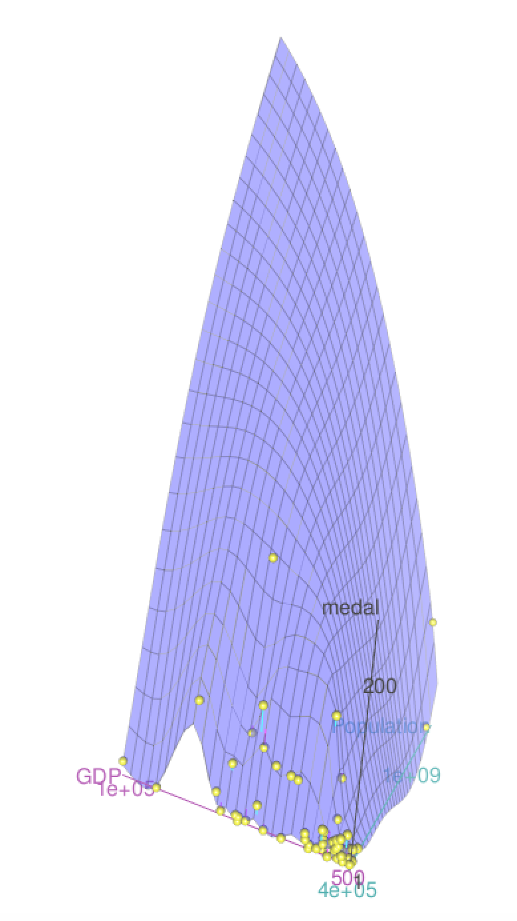
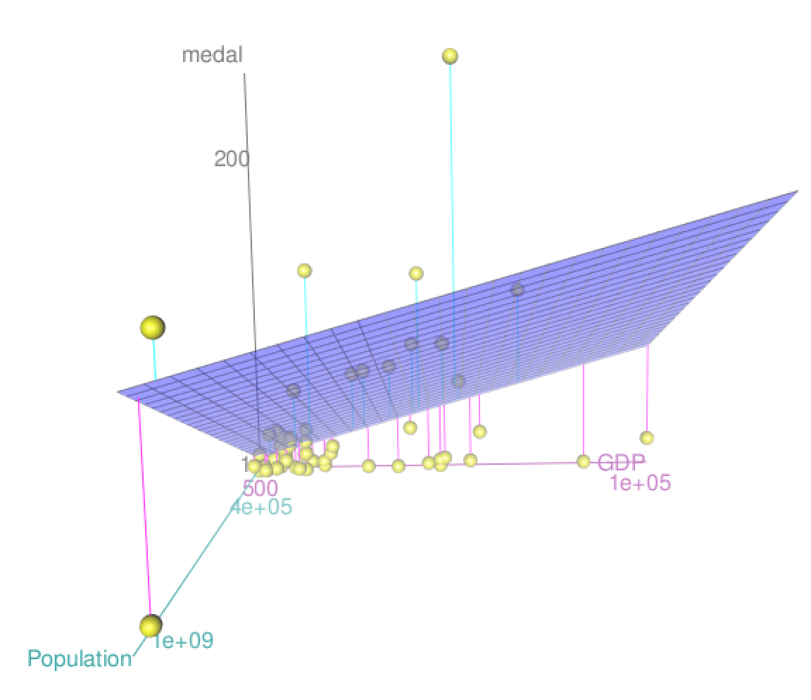
4. Final Model and Discussion
Linear regression model
Non-linear regression model
$$\hat{Medal}=−2.165×{10}^{−17}+0.3493×GDP+0.3776×Population+ε$$
$$\hat{Medal}=−235.8594+6.5721×{Population}^{0.16127}+60.9428 ×{GDP}^{0.10468}+ε$$

Slide 15
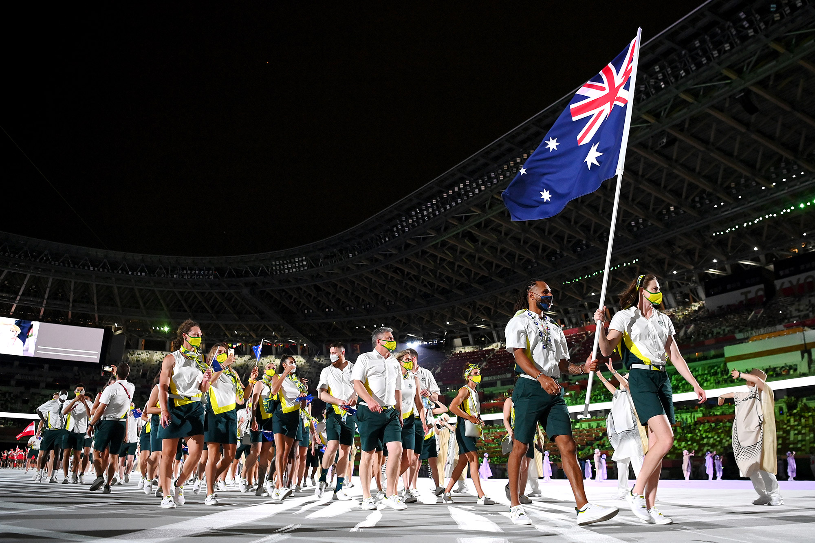

Evaluation and recommendations
General recommendations:
Increase size of contingent via female participation
Increase event participation by training athletes that participate in multiple events
Evaluation:
GDP and population can influence the number of medals won (R² = 0.4913)
EDA shows contingent and event participation are strongly correlated to medals won
More factors need to be explored – such as statistical significance of hosting the Olympics
Governments
Citizens of participating countries
Participating athletes
Sporting regulatory bodies
National Olympic Committees
Notes:
Our project focussed on answering: what factors most impact how many medals a country is likely to win?
We made 2 recommendations to our stakeholders who want to increase medal success:
That NOCs and Governments should focus on engaging women participation – to increase overall contingent.
And to invest in training multi-skilled athletes (such as those in swimming, athletics and gymnasts).
The model we developed found a non-linear relationship between medals won and both GDP and population, but due to low R squared values, we should consider contingent and event participation to increase predictive power.
A limitation of the model is that it was made from data pertaining to a single Olympics, and should be further optimised for other Olympic games, as well as winter games.
Lastly, there are many other factors – such as significance of hosting the Olympic games, which might be looked at for further study.

Slide 16
GOING FOR GOLD: predicting Nations Olympic medal performance
Group 9
Linyuan Xing
Jingxin Nie
Mark Mendoza
Timothy Le Pers

